Slide 1
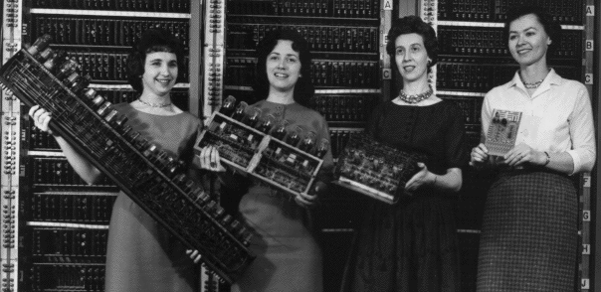
“An Instructional Program to Improve the Enrollment and Retention of Women in Computer Science at FRSD”
Patron: Mrs. Amy Qu – Google College Liason
Funding request: Google Educational Grant
Presenter: Naeem Hossain
Presentation Date: 5/1/17

Slide 2
Industry-Level Problems
Only 18% of graduates into the tech industry are women (National Center for Women in Information Technology, 2012, p. 16)
The number of female computer science majors fell by 43% from 2005-2007 (Hossain & Robinson, 2012, p. 444)
74% of high school girls are interested in computer Science (Modi et. al, 2012, p. 2)
Susan Fowler, a high-profile ex-Uber employee, details an industry-wide problem of sexual harassment

Slide 3
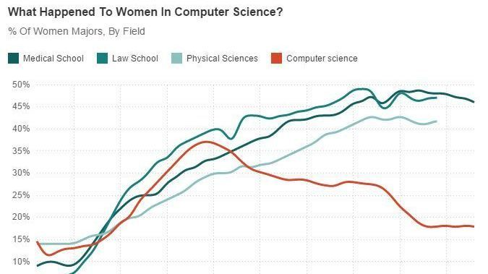
Source: NPR

Slide 4
Problems at the local level
In FRSD, only 350 women out of 6000 surveyed female students had any interest in purusing tech after graduation (Freehold Regional High School District, 2016, p. 4).
This is below the national average
Gender gaps are bad and systemically harm women – less access to opportunity
Need women to fill jobs:
At current graduation rates, US tech grads can only fill 30% of computing jobs by 2020 (National Center for Women in Information Technology, 2012)
Women remain a huge, untapped resource for the industry

Slide 5
Causes of the problem at FRSD
Access to computer science courses
Teachers’ are not aware or aren’t trained in computer science
No administrator knowledge on how to solve the problem
Unaware of example models such as Girls Who Code or Microsoft TEALS

Slide 6
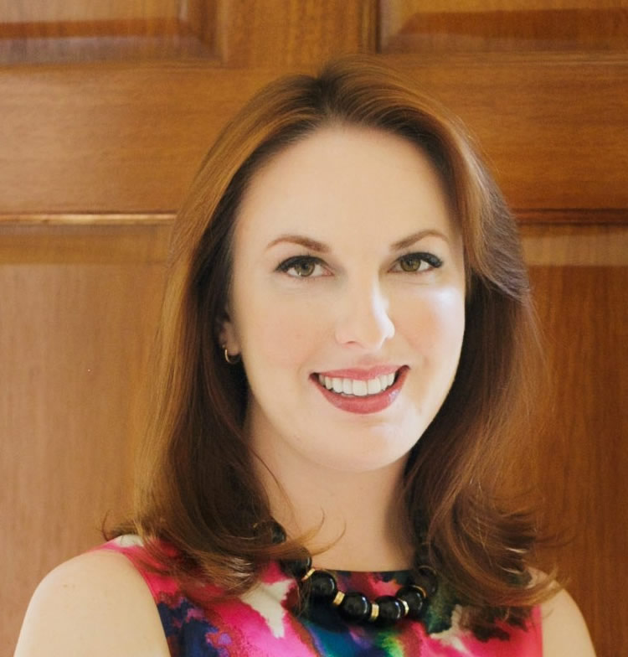
Researcher: Sarah-Jane leslie
Professor of philosophy and education at Princeton University
Meta-study on women in STEM fields, encompasses tech
Groundbreaking research into
confidence gap
Consistent across diverse backgrounds,
income levels, etc.

Slide 7
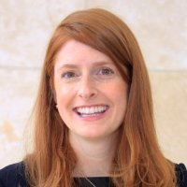
Researcher: Rosemary L. Edzie
University of Nebraska-Lincoln
Societal pressures that prevent women from entering tech:
Explanation of confidence gap
Lack of role models
No exposure to computer science

Slide 8
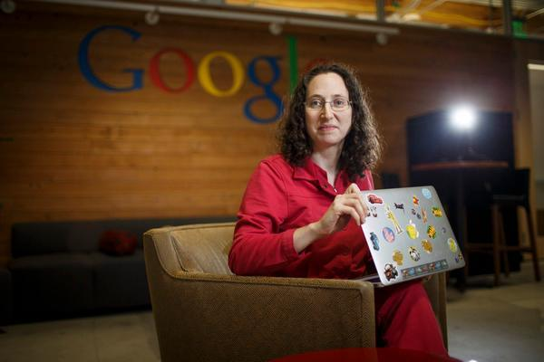
Researcher: Ellen Spertus
MIT researcher
Talks about historically low rates of retention in IT/CSRF
Endemic problems:
Sexual harassment
“Imposter Syndrome”
Few women to network
with
Gender norms and
stereotypes

Slide 9

Model: Girls Who Code
Girls Who Code
Wildly successful program afterschool tutoring program aimed at women that, as of 2016, helped 27,000 young women get a computer science education
For beginners
Revenue-positive
Results:
32% increase in
Computer science interest
Encourages female leaders in tech

Slide 10

Model: Microsoft TEALS
Technology Education and Literacy in Schools. In-school tutoring program that teaches computer science in-school through teacher-partnership programs
Basically volunteers act as TA’s in a class and help the teacher
Aimed at beginner teachers and students
Revenue-neutral
Results:
750 volunteers from 400
companies
10% increase in CS exam
scores

Slide 11
Plan
Afterschool tutoring program for young female students at FRSD
Details:
Held at Manalapan/Freehold Township High School Media Centers, and Barkalow Middle School (access to computers)
Over course of academic year, starting at the end of October
Funding provided by Google Educational Grant
Teachers provided are volunteers by Rutgers/local colleges
Costs $7500.00

Slide 12
Schedule
Over 2017 – 2018 academic year; one program for middle school and one for high school
May 21-31; Work with FRSD staff on logistics
June 10 – Sept 30: Advertise program to FRSD students and instructors/mentors at local colleges
Oct 1 – 10: Process applicants
Oct 17 – 25: Announcements
Oct 31: Launch
April 30, 2018 : End

Slide 13
Budget
Laptops
Lenovo M23 Chromebook Laptops ($5370.00)
Transportation
Subsidies for transportation ($1800.00)
Teaching supplies ($300)
Pens, pencils, notepads, etc.
Whiteboards, markers, etc.
TOTAL: ($7500.00)

Slide 14
Impact
Revenue gain
Donors
Money allocation
Increased motivation
Girls Who Code/Microsoft TEALS example
Reasons why there is more motivation
Foundation for future tech programs
Grow outreach with more local colleges
Expand on district->state level->interstate level
Future support
Incentive to support is more palatable

Slide 15
Discussion
Can measure success by simple surveys:
Emails surveys once a month
In-class surveys at least twice a month
Young women in the FRSD benefit in three ways:
Role model exposure, access to computer science educational resources, and opportunities for interacting with their peers
Want to see a 30% improvement in the number of women who are interested in computer science within 1 year
Want to expand the program to other districts and schools within 5 years

Slide 16
Works Cited
https://drive.google.com/open?id=0B2ckfm9IIOCCa2VKNTZmMndrTUU

